Slide 1

Say’s law of market
Principles of Macro Economics 1
ECONA 201

Slide 2
Say’s Law of Market
It states that ”supply creates its own demand”.
“It is production which creates market for goods”.

Slide 3
Say’s Law in a Barter Economy According to say, supply creates its own demand. This is explained as according to say, whatever is produced in the barter economy is sold out. Hence nothing remains unsold and there is no possibility of over production. As a result, there is no possibility of general unemployment. For example, if a person produces cloth whiles the other produce the wheat, they both exchange with one another. Hence nothing will remain unsold and no producer will face losses. Consequently, there will be no unemployment. In the barter economy people produced goods either for their own use or to exchange them with the other goods. So in this process there is an aggregate demand as well as aggregate supply. Under this mechanism, it is the value of good which clears the market. If the price of one good is higher than that of another good, the resources will shift from the production of low value good to the production of high value good. In this way the value of the good will fall where the resources are moving and value of the good will rise where from the resources are coming out. In this way equalization process starts till equilibrium value is settled in the market.
Monetary Economy with savings: In real life people do not spend their entire income on goods and services. They do saving also. As a result aggregate demand in the economy falls to the extent of savings effected. However, classicals held the view that this law still applies despite of savings in the economy. Because people convert their savings into investment. As a result AD= C + I. If due to certain reasons, savings is more than investment, then rate of interest will change in such a manner that saving will become equal to investment. Concluding, Say’s law applies to monetary economy also.

Slide 4
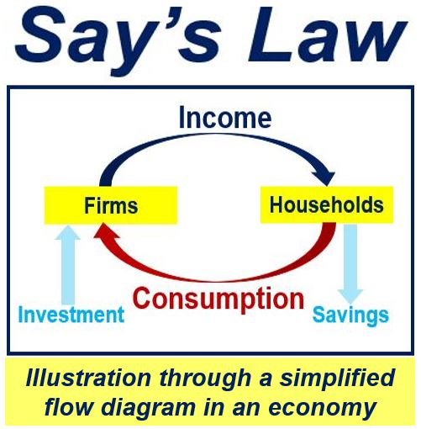

Slide 5


